Slide 1
Veterinary Clinic
Susan, Kyuss and Nina

Slide 2
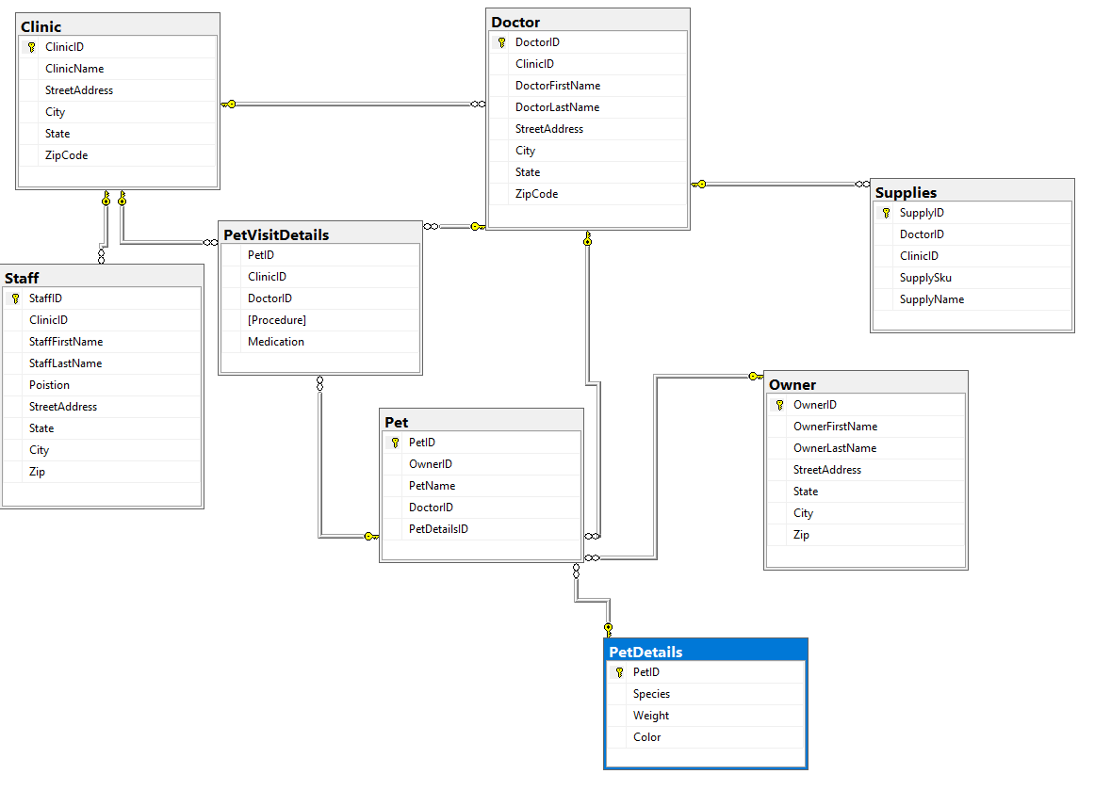
SQL

Slide 3
SQL Code
VetGenerator
Linked above is the github repo that contains the SQL code that creates a database and inputs values for each field.

Slide 4
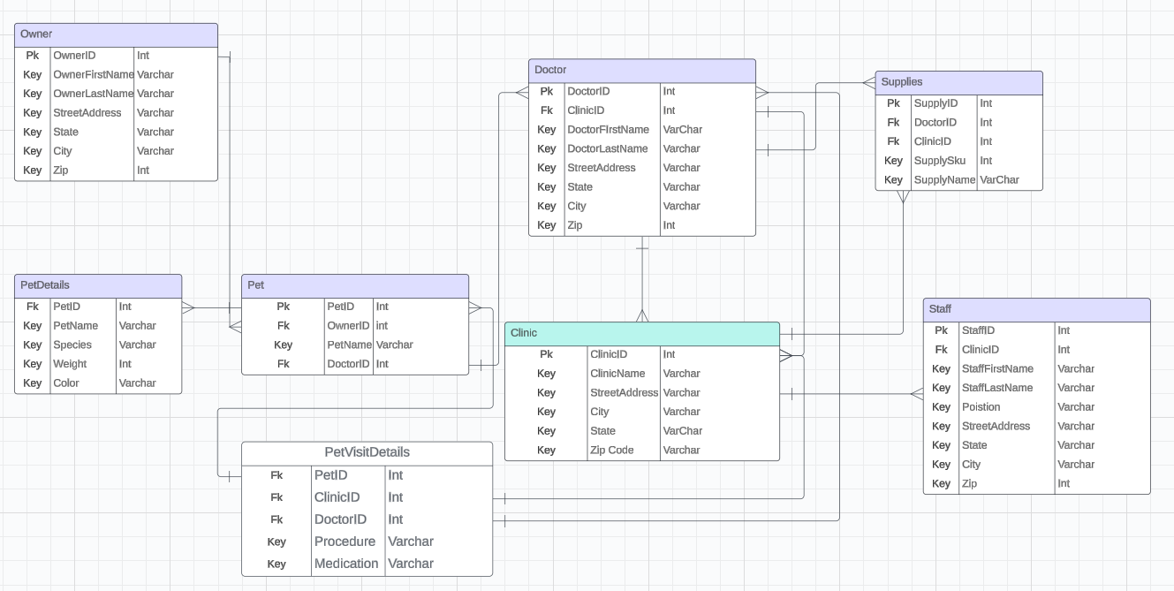
LucidChart

Slide 5
Conclusion
With the use of SQL and LucidChart, we were able to diagram how various entities in a simulated veterinary clinic relate, and how data is inputted into each field.

